Slide 1
DR .ABHISHEK SINGH PARIHAR
• FELLOWSHIP IN REPRODUCTIVE MEDICINE & IVF, CRAFT Hospital,Cochin • Ultrasound training from Craft hospital, Cochin, Kerala
and Institute of Ultrasound Training, Delhi
• MS Obs & Gyne, RGUHS Bangalore (2008)
• MBBS Pondicherry University (2003)
AREAS OF CLINICAL INTEREST
Reproductive Medicine, IVF, Andrology
Member :
Federation of Obstetrics and Gynecological societies of India (FOGSI)
Ghaziabad Obsterics and Gynecological society
Gynecological Endocrine Society of India (GESI)
Indian Medical Association (IMA), Ghaziabad branch
Delhi Gynecologist’s Forum (DGF)
Indian Fertility Society (IFS)
Invited as guest speaker at various societies & Conferences
Executive member, Ghaziabad Obs & Gynec Society

Slide 2
INTRAUTERINE INSEMINATION
DR. ABHISHEK SINGH PARIHAR
M.S.( OBS & GYNAE), FELLOW REPRODUCTIVE MEDICINE.
CONSULTANT : Life care IVF Center, New Delhi
Abalone Clinic, Maternity & Fertility Center, NOIDA

Slide 3
Infertility
Infertility is defined classically as the inability to conceive after 1 year of unprotected and regular intercourse. This definition is based on the cumulative probability of pregnancy.

Slide 5
CAUSES OF FEMALE INFERTILITY

Slide 6
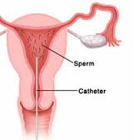
INTRAUTERINE INSEMINATION
IUI places sperm directly into the uterus and therefore close to any egg(s).
Less stressful, LESS invasive and expensive than IVF and similar procedures. It is therefore often used when a male partner is subfertile, or when the reason for not becoming pregnant is unknown.

Slide 7
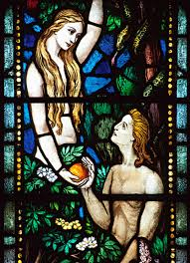
History
Oldest assisted reproductive technique
Most widely used worldwide
A I techniques were first investigated in the 17th century, as a treatment for infertility related to male sexual dysfunction (e.g. the inability to ejaculate).
Dutch scientists first reported conception following artificial insemination in 1742, when they successfully fertilised the eggs of fish, by artificially inseminating female fish with fish sperm.
Human insemination began in the late 18th century
Instrument called the Fecondateur, a syringe to assist insemination, was developed in 1866.

Slide 8
History of IUI
As a technique:
Direct intrauterine insemination (neat semen)
- Disadvantage:
- PG cramps
- Infection.
Split ejaculate
The advances in IVF, ET. reviving IUI.
Abandoned (Stone et al, 1986)

Slide 9
Reviving the interest in IUI
Advances in:-
Progress in semen processing and sperm isolation methods.
Improved ovarian stimulation protocols (developed primarily to meet IVF requirements) →↓ ↓side effects.
+
IUI progress is due to advances in IVF, ET.

Slide 10
Advantages of IUI
Bypass ( Vaginal acidity + cervical mucus hostility)
Deposition of a well prepared sperms as close as possible to the oocytes (Short distance)
Non invasive
Inexpensive.
Antenatal & perinatal complications ( similar to pregnancies from normal S I)

Slide 11
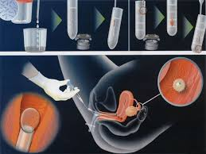
STEPS OF IUI
Patient selection and work-up
Ovarian stimulation
Monitoring of follicular growth and endometrial development
Timing of insemination
Number of inseminations
Semen preparation
Insemination procedure
Luteal support

Slide 12
PREREQUISITES
Age < 40 years
Patient capable of spontaneous or induced ovulation
Atleast one patent fallopian tube with good tubo- ovarian relationship
Sperm count of more than 10 million/ml pre-wash or a post-wash count of >3-5 million motile sperms with percentage motility of more than 40%
Easy access to the uterine cavity via a negotiable cervical canal

Slide 13
Controlled ovarian stimulation along with intrauterine insemination –effective form of treatment - select group of couples.

Slide 14
INDICATIONS
Male factor
Female factor

Slide 15
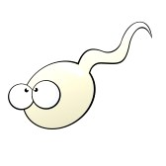
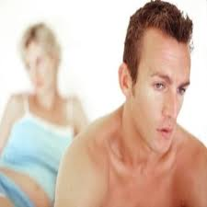
Male factor
Subnormal semen parameters
Oligozoospermia, Asthenozoospermia, Teratozoospermia, Hypospermia, Highly viscous semen
Retrograde ejaculation.
Ejaculatory failure-
Anatomical
Neurological
Psychological
Drug induced

Slide 16
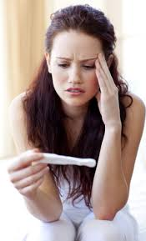
Female factor
Unexplained infertility
Cervical factor ( Cervical mucus hostility, poor cervical mucus ) , Antisperm antibodies
Ovulatory dysfunction (ovulating but no pregnancy and associated with male factor-ESHRE/ASRM)
Minimal to mild endometriosis
Vaginismus
Allergy to seminal plasma
HIV serodiscordant couples

Slide 17
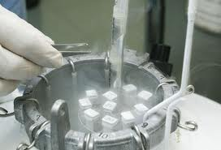
Cryopreserved samples
Absentee husband
Anti – neoplastic treatment
Vasectomy
Poor semen parameters
Drug therapy

Slide 18
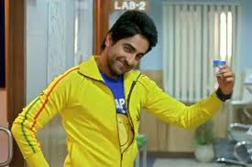
IUI with Donor Sperm
Severe abnormal semen parameters ( OAT ).
Azoospermia ( OA – CBAVD, NOA)
Hereditary disease in male partner.
Repeated failure at IVF/ICSI.
Infectious disease in male partner( HIV).
Severe Rh incompatibility
Single Women

Slide 19
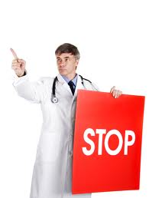
CONTRAINDICATIONS
Tubal pathology
Genital tract infection
Severe male factor infertility
Severe endometriosis
Genetic abnormality in husband
Unexplained genital tract bleeding
Older women more than 40 years
Multiple failures at IUI

Slide 20
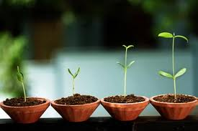
Ovulation induction
Oral drugs
Oral drugs with gonadotropins
Gonadotropins alone
Gonadotropins with Gnrh analogs
Gonadotropins with Gnrh antagonists

Slide 21
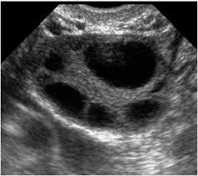
Rationale and aim of ovulation induction for IUI
Anovulatory women – Monofolliculogenesis.
Ovulatory women – Super ovulation to increase the chance of pregnancy as more eggs will be available for the sperms to fertilize.

Slide 22
Ideal ovarian stimulation protocol??
Maximizes conception- ideally expressed as singleton live birth at term.
Minimizes multiple pregnancy and OHSS.
Avoiding risks of preterm delivery, perinatal morbidity and mortality to the neonate and risks to the mother from OHSS

Slide 23
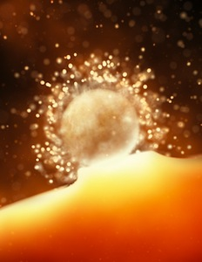
Ovulation Trigger
HCG
Gnrh AGONIST
Recombinant HCG.
Routine administration of HCG adds little to improving conception rates .Indicated only when absent or delayed ovulation or for timing IUI or intercourse.
(Fertil steril 2007)

Slide 25
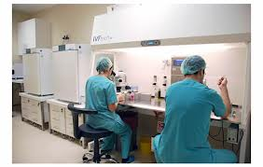
SEMEN PREPARATION TECHNIQUES
Standard sperm wash
Swim up
Swim down method
Density gradient

Slide 26
Semen preparation for IUI - Objective
Remove PG’s- cause uterine cramping.
Semen mixed with buffered solution with human serum albumin.
Advanced preparation -selects motile & superior quality sperm.
Dead/ immotile/abnormal sperms- produce 10-15 times more Reactive oxygen species than motile sperms.
High level of ROS – reduces fertilization potential.

Slide 27
Semen requirements
Threshold
Pre wash
Total count- 10 million
Motility -30 %
Total motile forms-
5 million
Morphology - 5%
8% VS 2.5% Pregnancy rate per cycle
Post wash
4 – 5 million
50 %

Slide 28
Frequency of IUI
Single IUI.
36 hrs after HCG .
After follicle rupture .
Within 24 hrs of LH surge.
Double IUI.
At 24 and 48hrs after HCG adminstration.
Day 6 and day 8 of last pill .
NO statistical difference in pregnancy rates in different timing regimens.
(Esra et al –Fert ster 2009)

Slide 29
Single Vs double IUI
RATIONALE- increase opportunity for longer fertilization period (22-47hrs).
No clear benefit in terms of LBR.
(TafunBagis etal - Human Rep ,May 2010)
Systematic review of 3 RCT- No difference.
(NICE guideline-fertility-2004)
No clear benefit in terms of pregnancy rates.
(Meta analysis-Nikalaos-Fert stert Aug.2009.)

Slide 30
TIMING OF IUI
Pre- ovulatory USG.
Fresh unwashed semen - 6-8 hrs before ovulation.
Washed semen – No sooner than 4 hrs after ovulation.
Cryopreserved semen – As close to ovulation.
LH testing kit.
Within 24 hrs of color change .

Slide 31
Methods of AI
Intra vaginal insemination
Intra cervical insemination
Intra uterine insemination
Intra uterine tuboperitoneal insemination
Direct intra peritoneal insemination
Fallopian tube perfusion .

Slide 32
IUI procedure

Slide 33
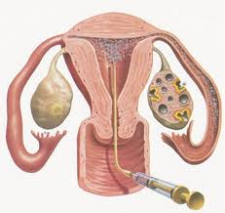
IUI procedure
The patient is positioned .
Cervix exposed with cuscos bivalve speculum, excessive vaginal secretions are wiped away and the cervical os is cleansed with the standard buffer solution using a cotton swab.
IUI cannula is flushed with 1-2 ml of flushing media to wash away any toxic factors present.

Slide 34
Specimen ( 0.4- 0.5ml) drawn into the catheter and syringe.
The catheter is gently introduced into the cervix to pass beyond cervical os until the catheter enters the uterus.
The catheter is advanced to a depth of at least 4cm but no more than 6cm to avoid trauma to the endometrium
When the catheter is in place and before ejecting the specimen , the opened forceps is positioned on either side of the cervix and the opposing ends gently squeezed together with just enough pressure to prevent fluid escaping .

Slide 35
The specimen is slowly ejected from the syringe.
The air remaining in the syringe is expressed as the catheter is withdrawn, to form an air block in the cervix.
Pressure on the forceps should be maintained until the cramping subsides, usually within one minute

Slide 36
Role of bed rest after IUI
15 min of bed rest after IUI has shown to improve ongoing pregnancy and LBR
(RCT-Custers etal BMJ2009).

Slide 37
LUTEAL SUPPORT
Luteal support in IVF cycles is associated with increased pregnancy rates
Luteal support is necessary when Gnrh agonist,hcg and antagonist is used.
Luteal support in the form of various forms of progesterone and HCG can be given depending on the clinical situation.

Slide 38
Luteal support
Oral dydrogesterone 10 mg BD from day of IUI.
Micronized progesterone 100 mg BD vaginally.
Inj. Hcg 3000 iu i.m. once every 3days.
Role of estradiol is not clearly defined.

Slide 39
Success rates
08 -14% per cycle for all causes of infertility.
Semen parameters- Count , Motility and Morphology
(Van et al—Fert & Ster 2001)
(Lee et al –Int.J.Andr,2002)

Slide 40
Factors affecting success of IUI
Couple:
(Age, Duration of infertility, Cause of infertility, BMI).
Treatment:
Semen processing technique.
Protocol of COH.
Timing of insemination.

Slide 41
Prognostic factors
Age
Semen source and quality
No of follicles
Reason for treatment
Previous treatment cycles

Slide 42
COMPLICATIONS
Failure of treatment
Pelvic infection: 0.01-0.2%
Uterine contractions and anaphylaxis
OHSS < 1%
Multiple pregnancy
Ectopic pregnancy
Miscarriages
Pain and vaso vagal attack

Slide 43
Conclusion
While many gynecologists offer IUI office procedure, many of them are not specialized enough to provide a comprehensive service. This means that:
1. Patients need to run from gynecologist to ultrasound scan center to the lab.
2. Fragmented care because of poor coordination.
SO
An ideal clinic is that which offers all the services under one roof.

Slide 44
THANK YOU !!

